Slide 1
Course code and Name: CHEM 111and Chemistry
Periodic Properties
Professor Dr. Muhammed Shah Miran
Department of Chemistry
University of Dhaka
Dhaka 1000

Slide 2
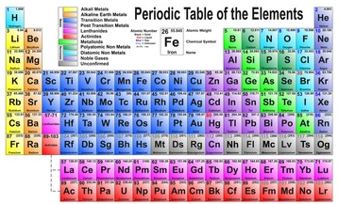

Slide 3
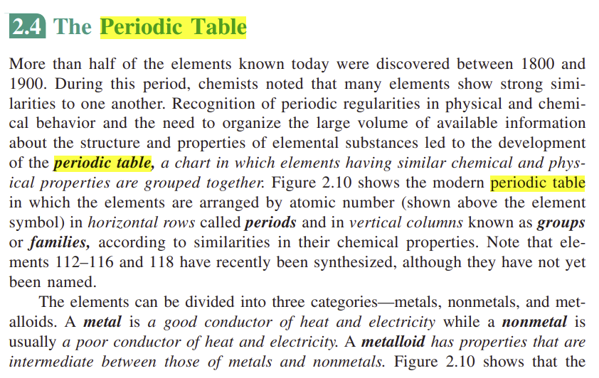















Slide 4
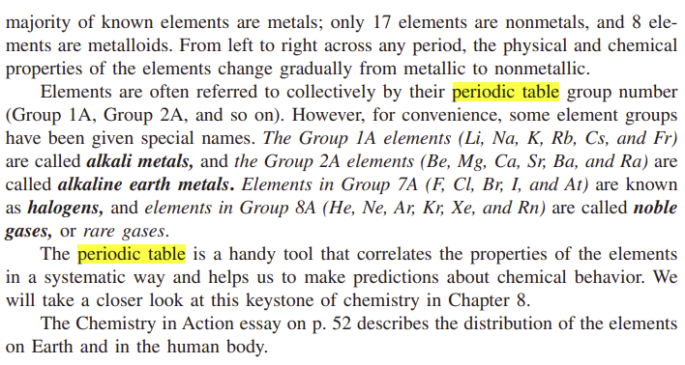



















Slide 5
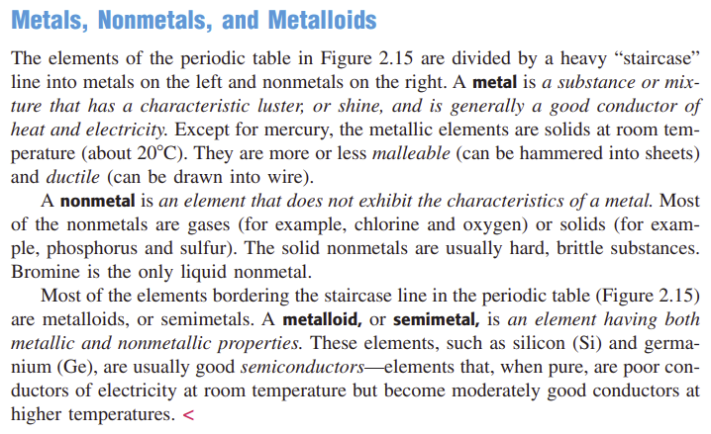


Slide 6



Classification of elements
The representative elements (also called main group elements ) are the elements in Groups 1A through 7A, all of which have incompletely filled s or p subshells of the highest principal quantum number
The transition metals are the elements in Groups 1B and 3B through 8B, which have incompletely filled d subshells, or readily produce cations with incompletely filled d subshells. (These metals are sometimes referred to as the d -block transition elements.)
The lanthanides and actinides are sometimes called f -block transition elements because they have incompletely filled f subshells.

Slide 7
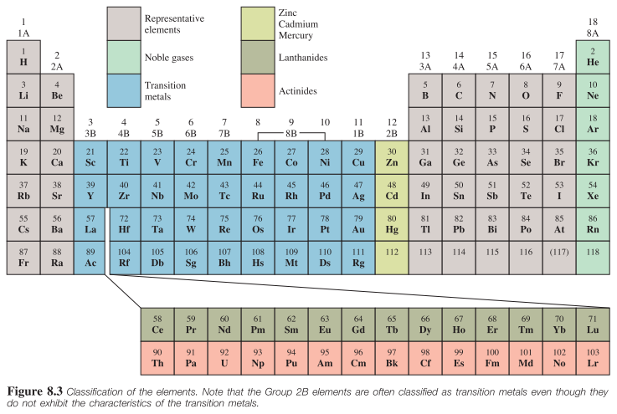

Slide 8





Classification of elements
The chemical reactivity of the elements is largely determined by their valence electrons, which are the outermost electrons . For the representative elements, the valence electrons are those in the highest occupied n shell. All nonvalence electrons in an atom are referred to as core electrons. Looking at the electron configurations.

Slide 9
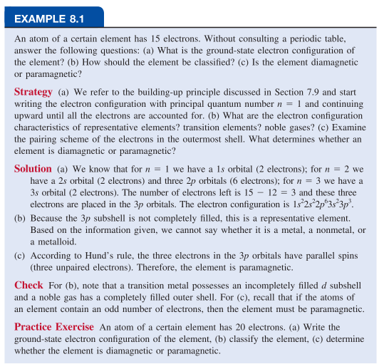





Slide 10
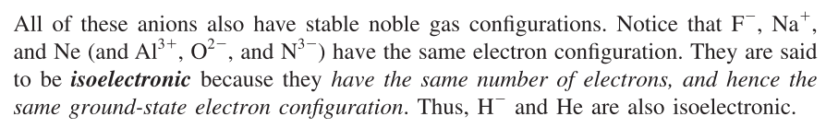
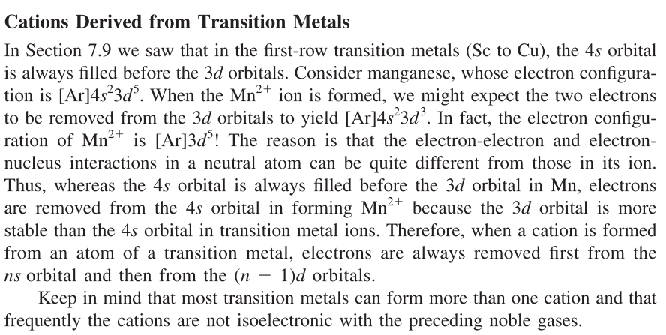






Electron Configurations of Cations and Anions

Slide 11
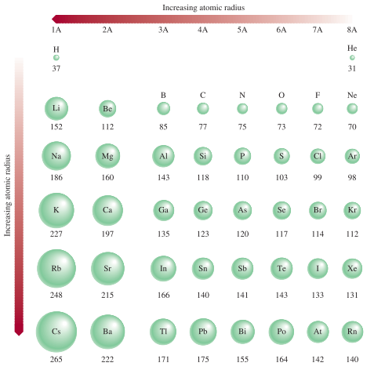
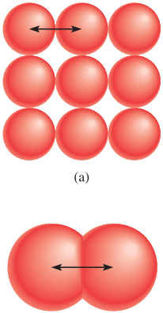
Atomic radius
Atomic radius, which is one-half the distance between the two nuclei in two adjacent metal atoms or in a diatomic molecule.

Slide 12
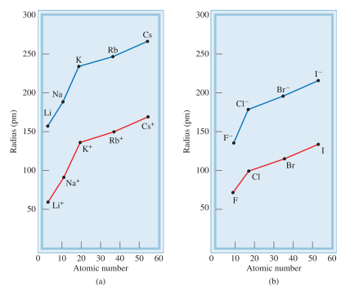
Ionic radius
Ionic radius is the radius of a cation or an anion.

Slide 13
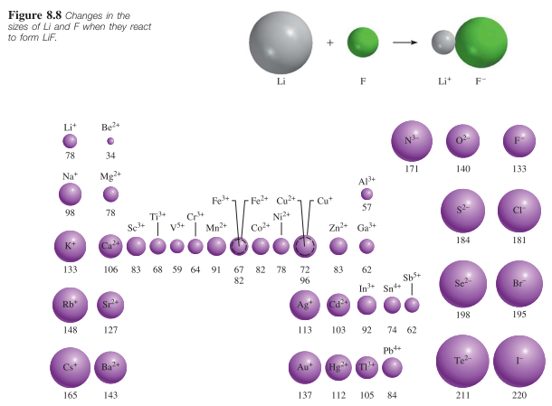




Ionic radius

Slide 14
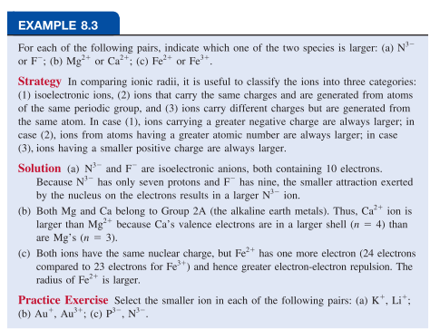
Ionic radius

Slide 15
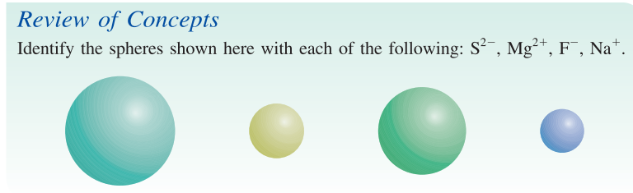




Ionic Radius

Slide 16
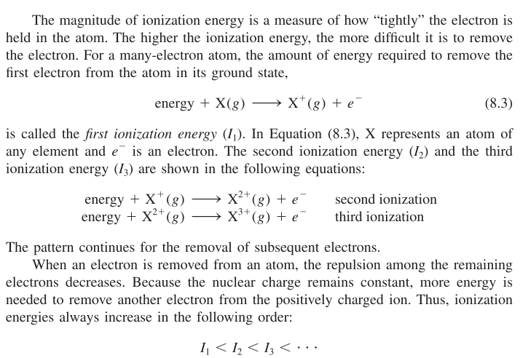







Ionization energy
Ionization energy is the minimum energy (in kJ/mol) required to remove an electron from a gaseous atom in its ground state.

Slide 17
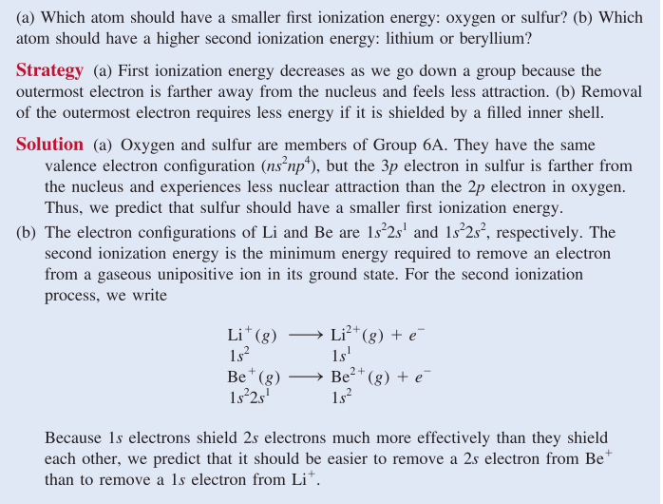
Ionization energy

Slide 18

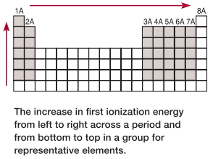
Ionization energy

Slide 19
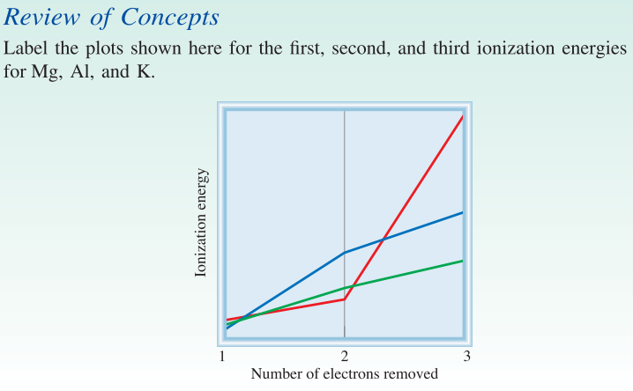



Ionization energy

Slide 20
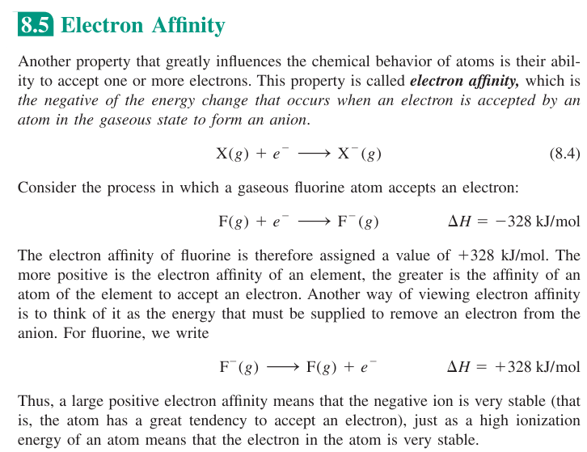


Electron affinity

Slide 21
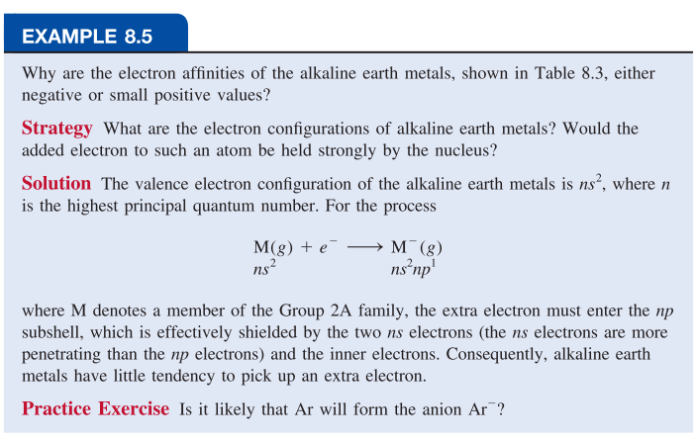
Electron affinity

Slide 22
Electronegativity vs Electron affinity
Electronegativity and electron affinity are related but different concepts. Both indicate the tendency of an atom to attract electrons. However, electron affinity refers to an isolated atom’s attraction for an additional electron, whereas electronegativity signifies the ability of an atom in a chemical bond (with another atom) to attract the shared electrons. Furthermore, electron affinity is an experimentally measurable quantity, whereas electronegativity is an estimated number that cannot be measured.

Slide 23







General Trends in Chemical Properties
Diagonal relationships are similarities between pairs of elements in different groups and periods of the periodic table. Specifically, the first three members of the second period (Li, Be, and B) exhibit many similarities to those elements located diagonally below them in the periodic table (Figure 8.13 ). The reason for this phenomenon is the closeness of the charge densities of their cations. (Charge density is the charge of an ion divided by its volume.) Cations with comparable charge densities react similarly with anions and therefore form the same type of compounds. Thus, the chemistry of lithium resembles that of magnesium in some ways; the same holds for beryllium and aluminum and for boron and silicon. Each of these pairs is said to exhibit a diagonal relationship. We will see a number of examples of this relationship later.

Slide 24
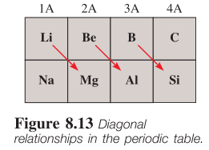
General Trends in Chemical Properties

Slide 25
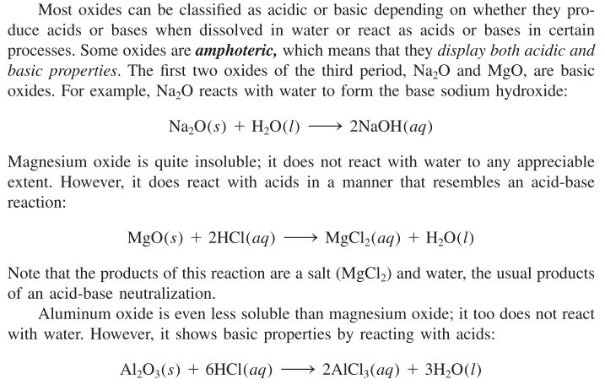





Properties oxides across a period

Slide 26
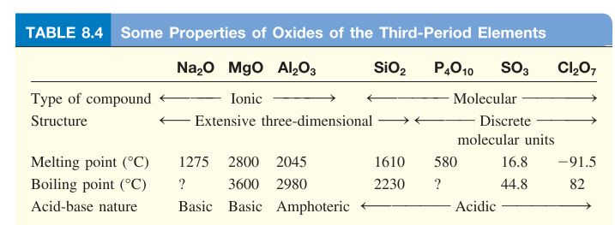
Properties oxides across a period

Slide 27
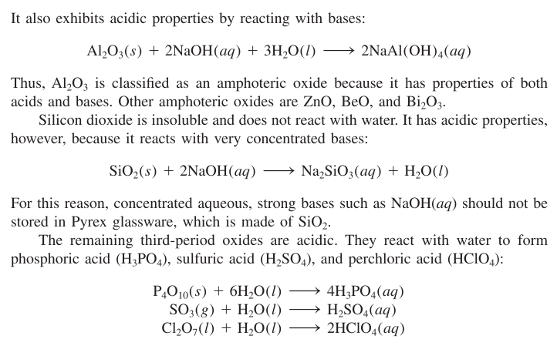



Properties oxides across a period

Slide 28
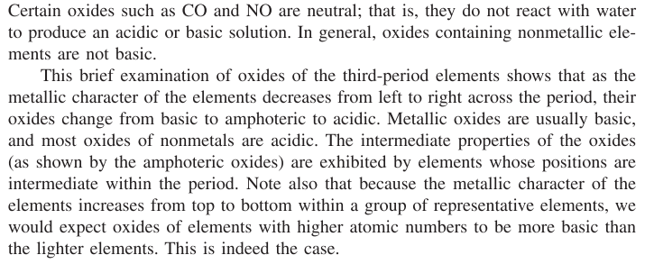





Properties oxides across a period

Slide 29
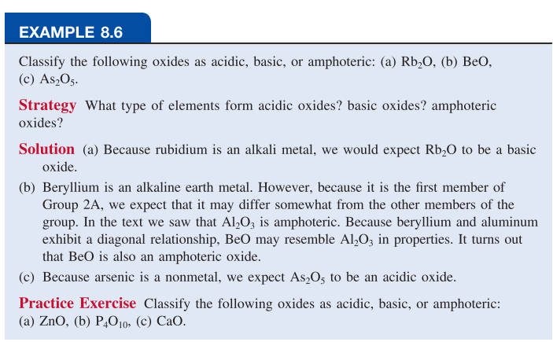
Properties oxides across a period

Slide 30
Questions
Why do Lithium (Li) and Magnesium (Mg) exhibit many similar chemical properties despite being in different periods and groups in the periodic table? Or write short notes on diagonal relationships. 3
Define ionization energy. Which of the following ionization process requires more energy, and why? 1+2
Mg(g) → Mg⁺(g) (ii) Mg⁺(g) → Mg²⁺(g)
3. Which atom should have a higher 2nd ionization energy: lithium or beryllium? 3
4. What is electron affinity? Differentiate between electron affinity and electro-negativity. 1+3
5. Classify the following oxides as acidic, basic, or amphoteric: ZnO, P₄O₁₀, CaO, BeO 2
6. List the following ions in order of increasing ionic radii: N³⁻, Na⁺, F⁻, Mg²⁺, O²⁻ Al³⁺ 3

